Slide 1
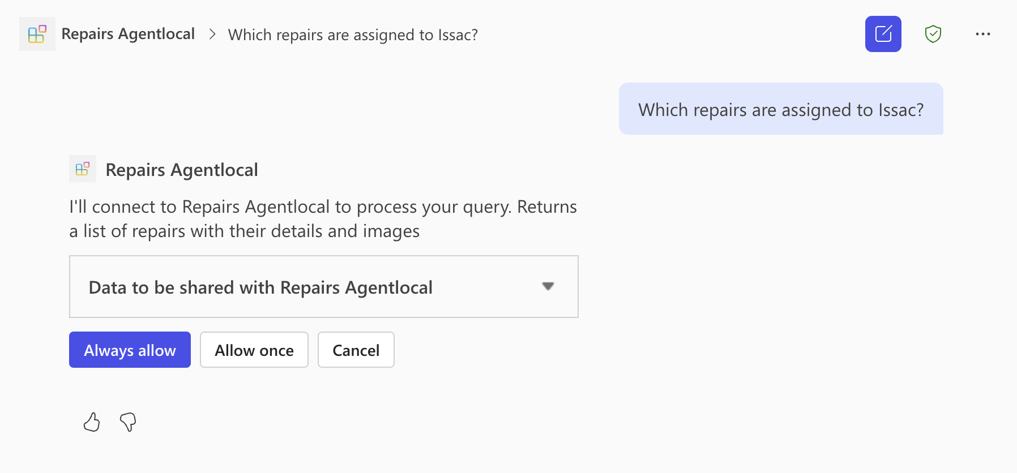
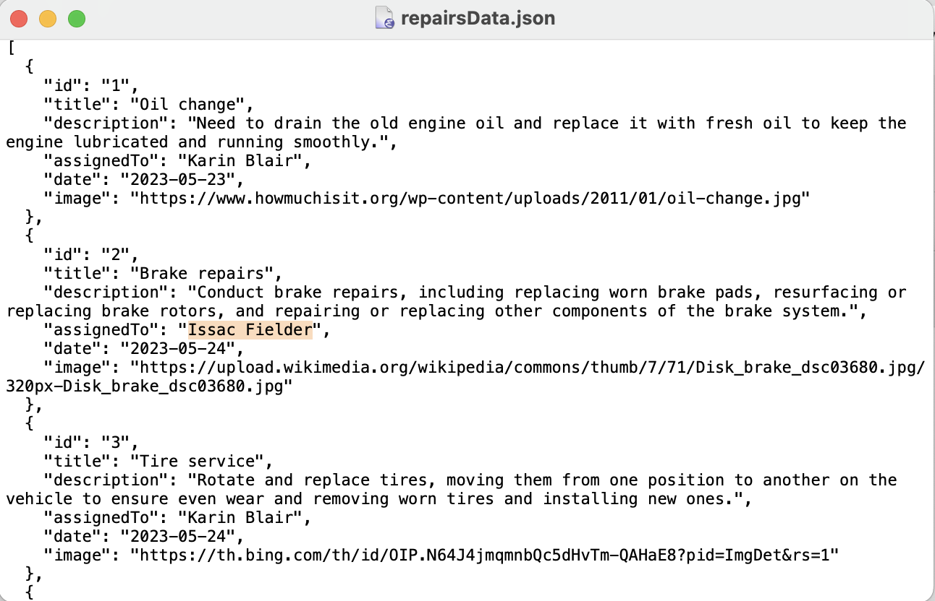
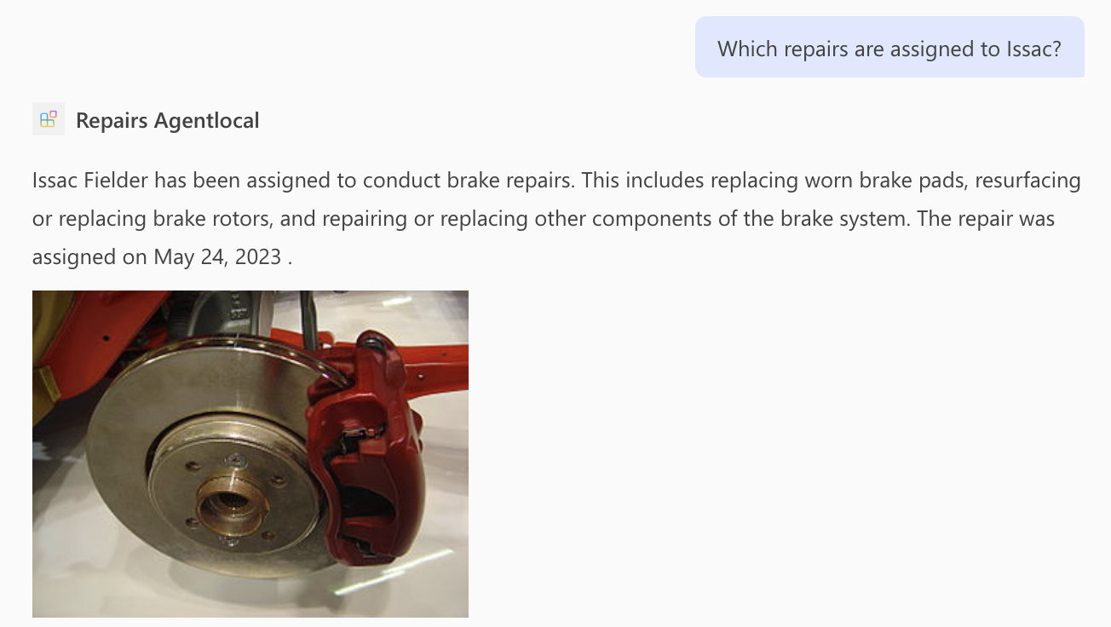
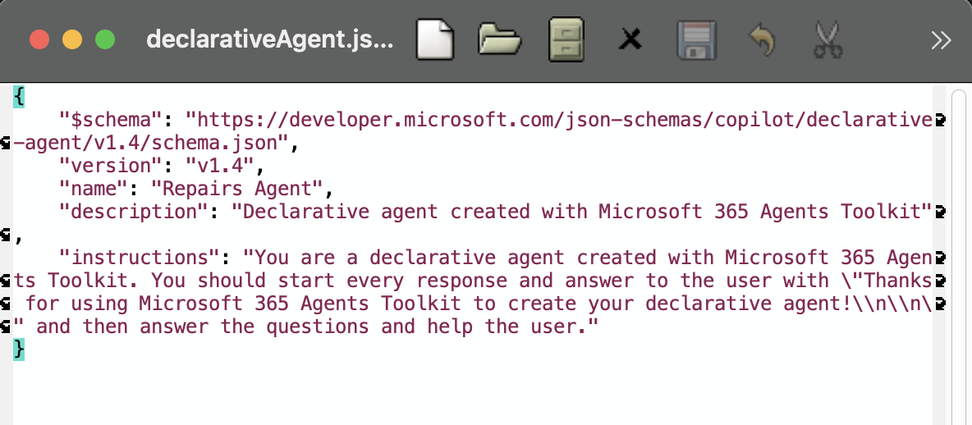
Deep search tools for SMARTech repository
Query
JSON data on local machine
Project outline
We want to create an open-source agentic RAG system for GT students to perform deep search on data sources
i.e. on SMARTech research papers
Students will be able to
Tailor the agent to expect specific types of questions related to their research
Prompt the agent, who will then search query a vector database for relevant documents and prepend as context
Receive a response with citations and backed-statistics from related documents
Microsoft 365 Copilot (A5 tier license provided by GT)
Users can create "declarative agents" that have access to locally hosted data (JSON) and can be tailored to specific tasks
Agents are able to search the web, run on GPT-4
With our plan, agents cannot view/search OneDrive and SharePoint files for context retrieval (requires purchasing Copilot add-on)
Response
Declarative agent manifest

Slide 2
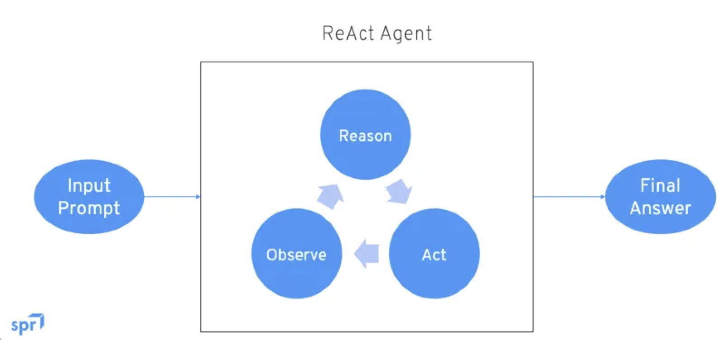
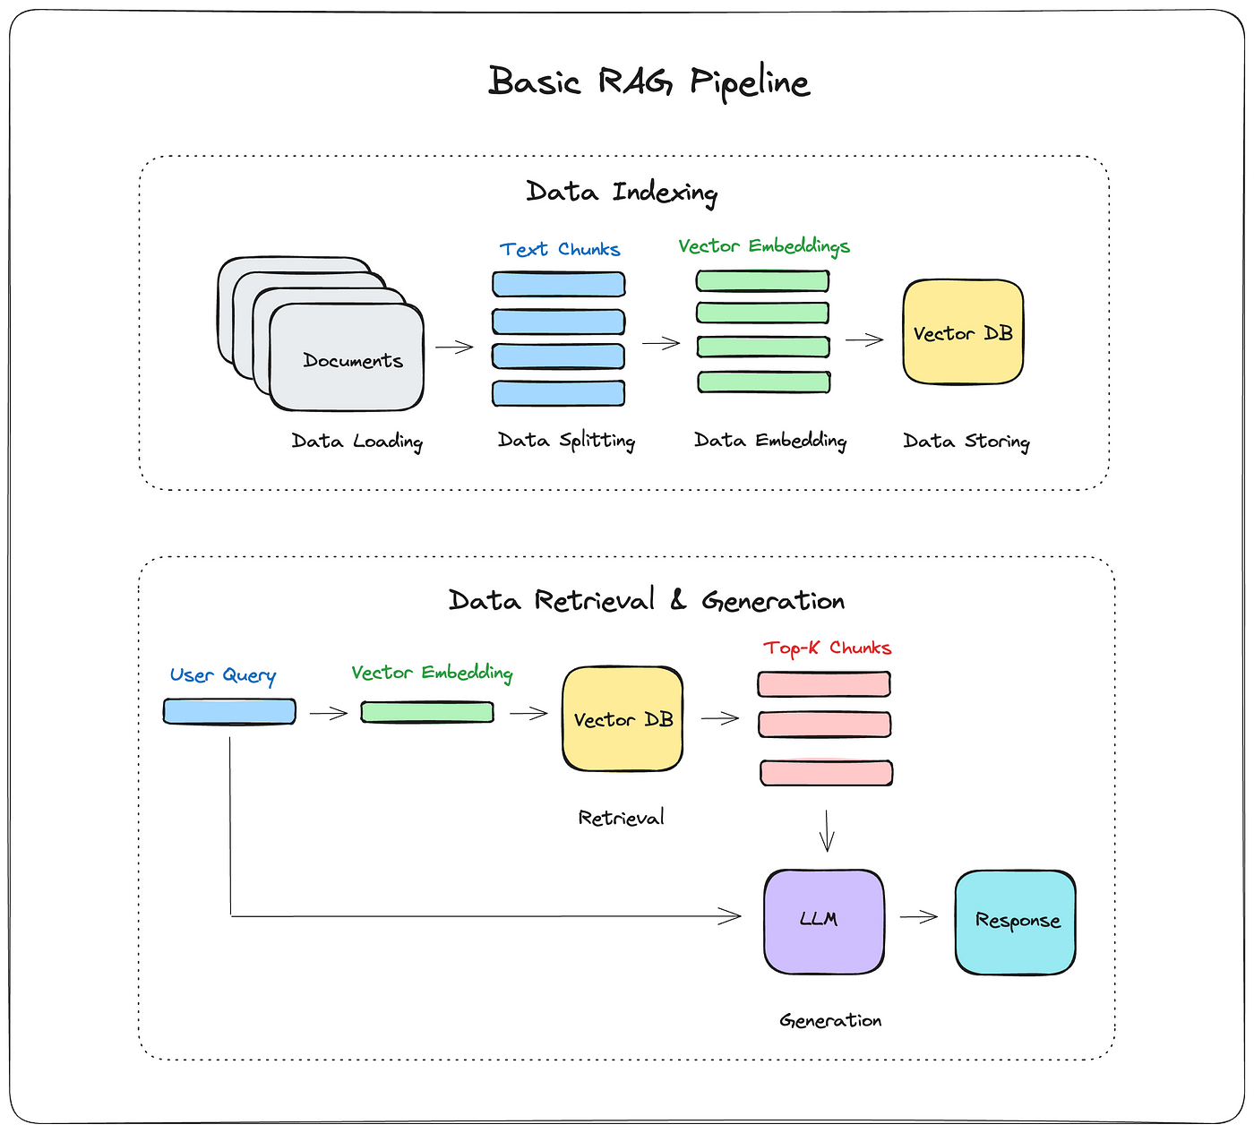
Open-source tool options
These setups will be closed ended – backend LLMs and other intermediate agents will run on PACE-ICE resources – no contextual data will be sent over external APIs or to third-parties.
LangChain (supports agents)
Native ReAct agents that are specified a backend LLM and given a list of tools to call (i.e. context retrieval tool, web search, call a calculator, etc.)
Tradeoffs – more built-in features, learning curve.
LlamaIndex (no agent support)
A straightforward context retrieval to LLM pipeline. Designed to retrieve context related to a query from a vector DB and feed it directly to an LLM. Less overhead compared to the other two options. Provides abstraction for vector DB management.
Fastest/most optimized option but difficult to scale (high maintenance).
Haystack (supports agents)
A more RAG oriented library that orchestrates in three main steps:
Retriever: Query is embedded and vector DB searched for top-k relevant documents
(Optional) Re-ranking: Among those top-k retrieved, run prompt w/each doc through a cross-encoder
Reader: A small LLM intakes the prompt + context and returns response
Easier to use, less tools than LangChain.

